Slide 1

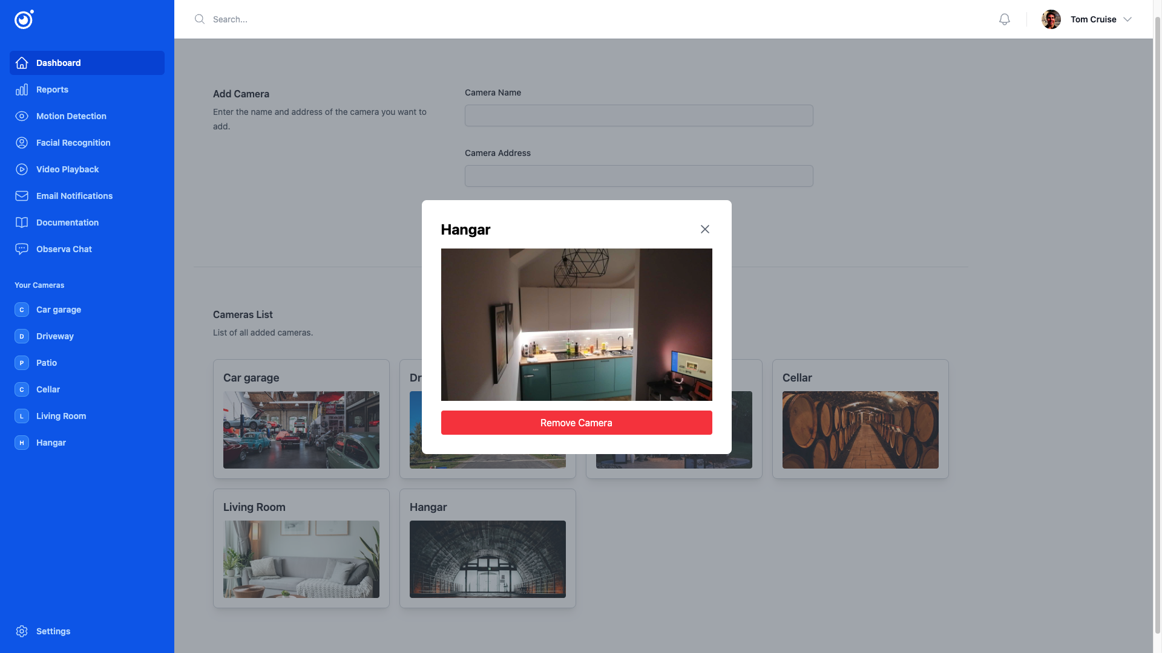
Observa
Observa
Video Surveillance System
Gregor Špan
Gal Dvoršak
Miha Čakš
Praktikum II
May 13 - June 13, 2024

Slide 2
Observa
🌐 Remote Access
👀 Live Observation
📱 Multi-Device support
🚶‍♂️ Motion detection
😃 Facial recognition
🎥 Video playback
📧 Email Notifications
📲 SMS Notifications
💬 Observa Chat
📊 Reports
Implemented functionalities

Slide 3






Observa
Technology
stack

Slide 4

Observa
Watch live stream video
Stay on top of your setup from anywhere with our easy-peasy web app. Hook up, keep tabs on, and boss around multiple cameras all at the same time.

Slide 5
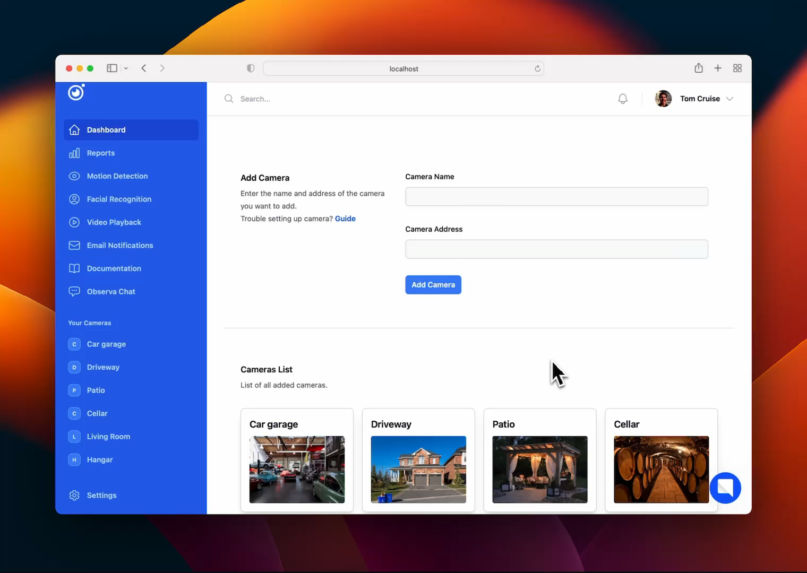
Observa
Utalize features like
🚶‍♂️ Motion detection
🎥 Video playback
😃 Facial recognition
📊 Reports

Slide 6

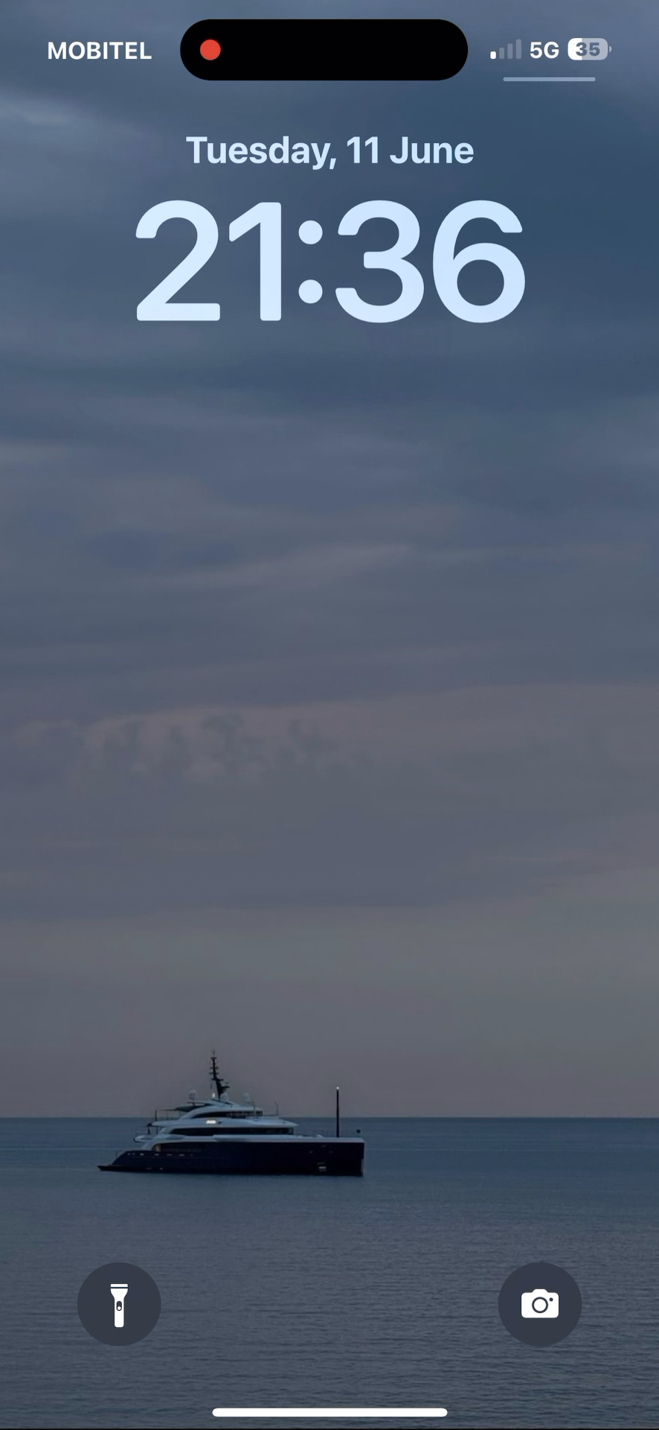
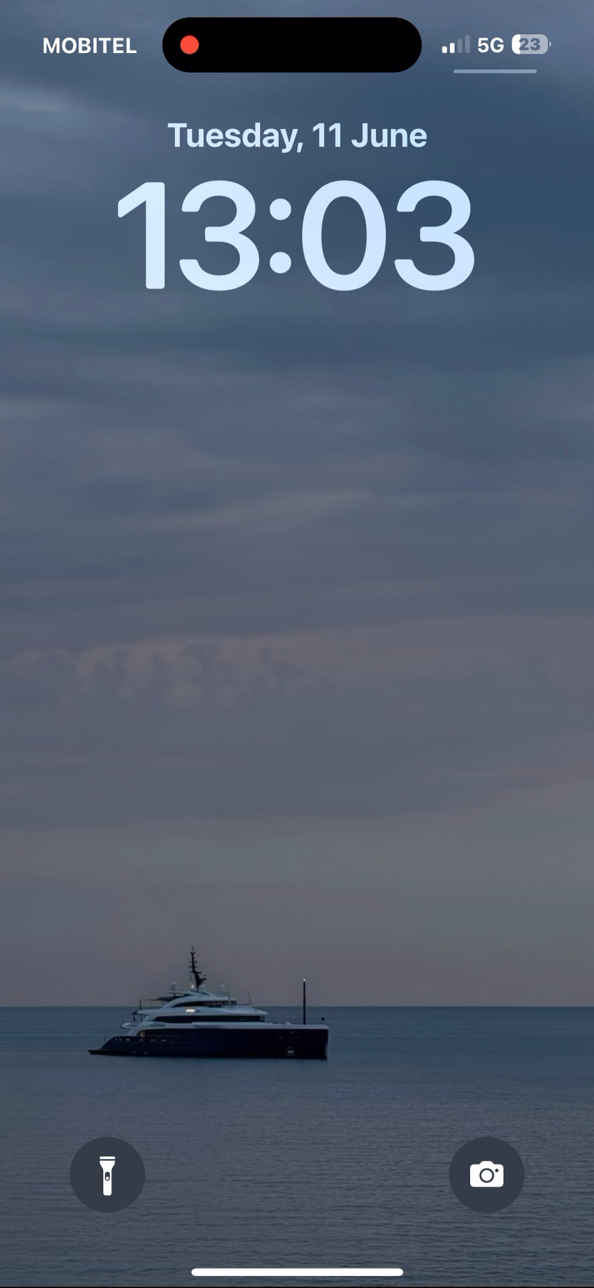
Observa
Recive alerts via Email & SMS
🚨
Set up subscriber list in settings
and be notified when the video surveillance system detects motion.

Slide 7

Observa
Custumize your profile
Manage your account through the "Your Profile" tab. Update avatar, edit name & email, change password, subscribe to motion detection alerts via email & SMS and delete account if needed.

Slide 8
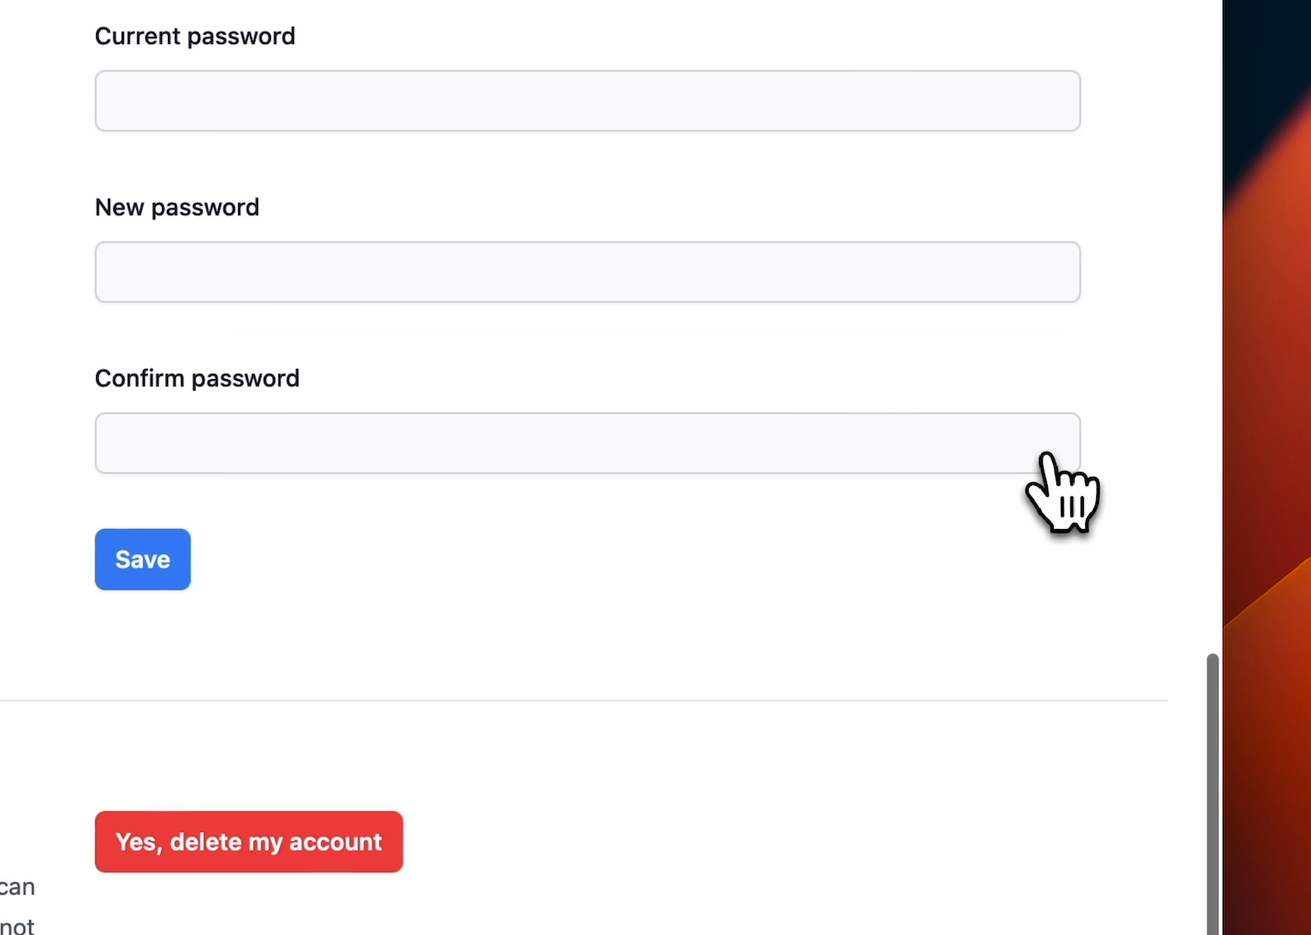
Observa
🤔
Have a problem and not sure what to do next?
🤖
Talk with our AI security specialist.
🛡️
Protect yourself with expert guidance.
Talk with our security specialist

Slide 9
Observa
Shortcomings & Possible improvements
⚙️ Improving Functionalities
Copy to clipboard
🔒 Security concerns
Dealing with high risk data
⏳ Loading Issues
Inconsistent live feed loading time
Intermittent camera loading issues
Video loading limit on deployment
❗
❗
Improving these vulnerabilities is crucial for maintaining a quality product

Slide 10
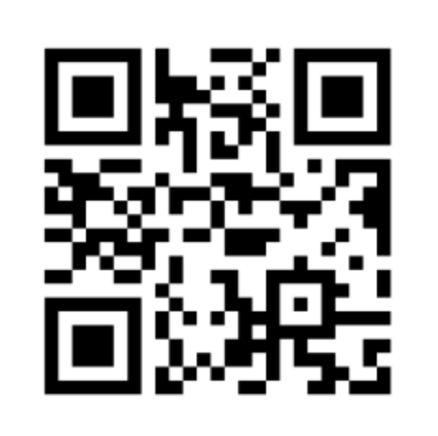
Observa
TRY IT NOW !
Note: You will be redirected to the landing page. Clicking the "Get Started" button will redirect you to the Observa web application. Please don’t change any settings.
Username: tom.cruise@maverick.com
Password: password1
🔑

Slide 11


Observa
Q&A
❓

Slide 12
Observa
Observa
Video Surveillance System
Gregor Špan
Gal Dvoršak
Miha Čakš
Praktikum II
May 13 - June 13, 2024

